Slide 1
RepoSync: Combined Action-Based and Data-Based Synchronization Model in Named Data Network
Weiqi Shi (Tsinghua University)
Alexander Afanasyev (University of California, Los Angeles)
18th IEEE Global Internet Symposium (GI 2015)
April 27, 2015

Slide 2






Introduction
File sharing: in great demand today
Sharing files among friends; joint authoring/editing; sharing files among one’s multiple devices
File synchronization models
Centralized model
simple implementation, but
centralized control
single point of failure
delivery model mismatch
Peer-to-peer model
decentralized control
no single point of failure, but
delivery model mismatch
underlying and p2p topology mismatch

Slide 3
Can We Synchronize Files in a True Peer-to-Peer Way in NDN?
Keep peer-to-peer decentralization
no single point of failure
Utilize data-centric architecture to support distributed applications
network-supported multicast
network-supported efficient data distribution
Notes:
multicast: the same data traverses link only once
efficient distribution: shortest path forwarding

Slide 4

NDN Overview: Basics
Two types of packets
Interest packet
name
optional selectors
Data packet
name
content
signature
Names defined by applications
/net/ndnsim/www/index.html/version=472
Interest packet
Name
Selectors (opt)
Data packet
Name
Content
Signature

Slide 5

NDN Overview: Data-Centricity
NDN separates
objective of retrieving
specifics of how to do it
Interest names exactly what to fetch
matching (secured) Data is retrieved by the network
from caches, in-network storage, or data producers
Caches
Interest
In-network storage
Data
Notes:
Interests should uniquely identify the requested Data

Slide 6
Features Made Possible by NDN
NDN name-based data retrieval
expressed Interest for the can bring data
from the local database
from the local environment (WiFi, LAN)
from the producer
from any other user sharing the same folder
Completely distributed, no need for central server
Can have backup storage which works just like any other device
Local communication is kept local
Data shared in multicast fashion
“Multi-peer-to-multi-peer” file sharing
NDN’s built-in security block to achieve app specific security goals

Slide 7
Data-Centric Chatroom Sync in NDN (ChronoSync/ChronoChat [1])
Sequence of Alice’s messages
Sequence of Ted’s messages
Sequence of Bob’s messages
Synchronization of distributed chat room dataset (set of sequences of chat messages) among the participants
[1] Z. Zhu and A. Afanasyev. Let’s ChronoSync: Decentralized dataset state synchronization in Named Data Networking. ICNP, 2013.
Notes:
ChronoSync assumes that each producer produce/name Data items sequentially
Producer status (prefix + latest sequence number) fully specifies how much and what Data has been generated

Slide 8
Data-Centric Action-Based Fileset Sync (ChronoShare/ChronoSync [2])
ChronoSync
ChronoShare
[2] A. Afanasyev, Z. Zhu, and L. Zhang. The Story of ChronoShare, or How NDN Brought Distributed Secure File Sharing Back. Tech.Rep., NDN-0029, 2015.

Slide 9
Synchronization Contradictions
Synchronizing directly on dataset
efficient for bulk changes
high overhead for small changes
Synchronizing action dataset
efficient for small changes
high overhead for large changes or changes with long history

Slide 10
RepoSync: Hybrid Action-Based and Data-Based Sync
Action-Based Synchronization
sync operations on the dataset
insert file
remove file
efficient for small modifications
Data-Based Synchronization
sync operations on dataset itself
snapshots of fileset state
sync fileset views
efficient for large amount of modifications

Slide 11
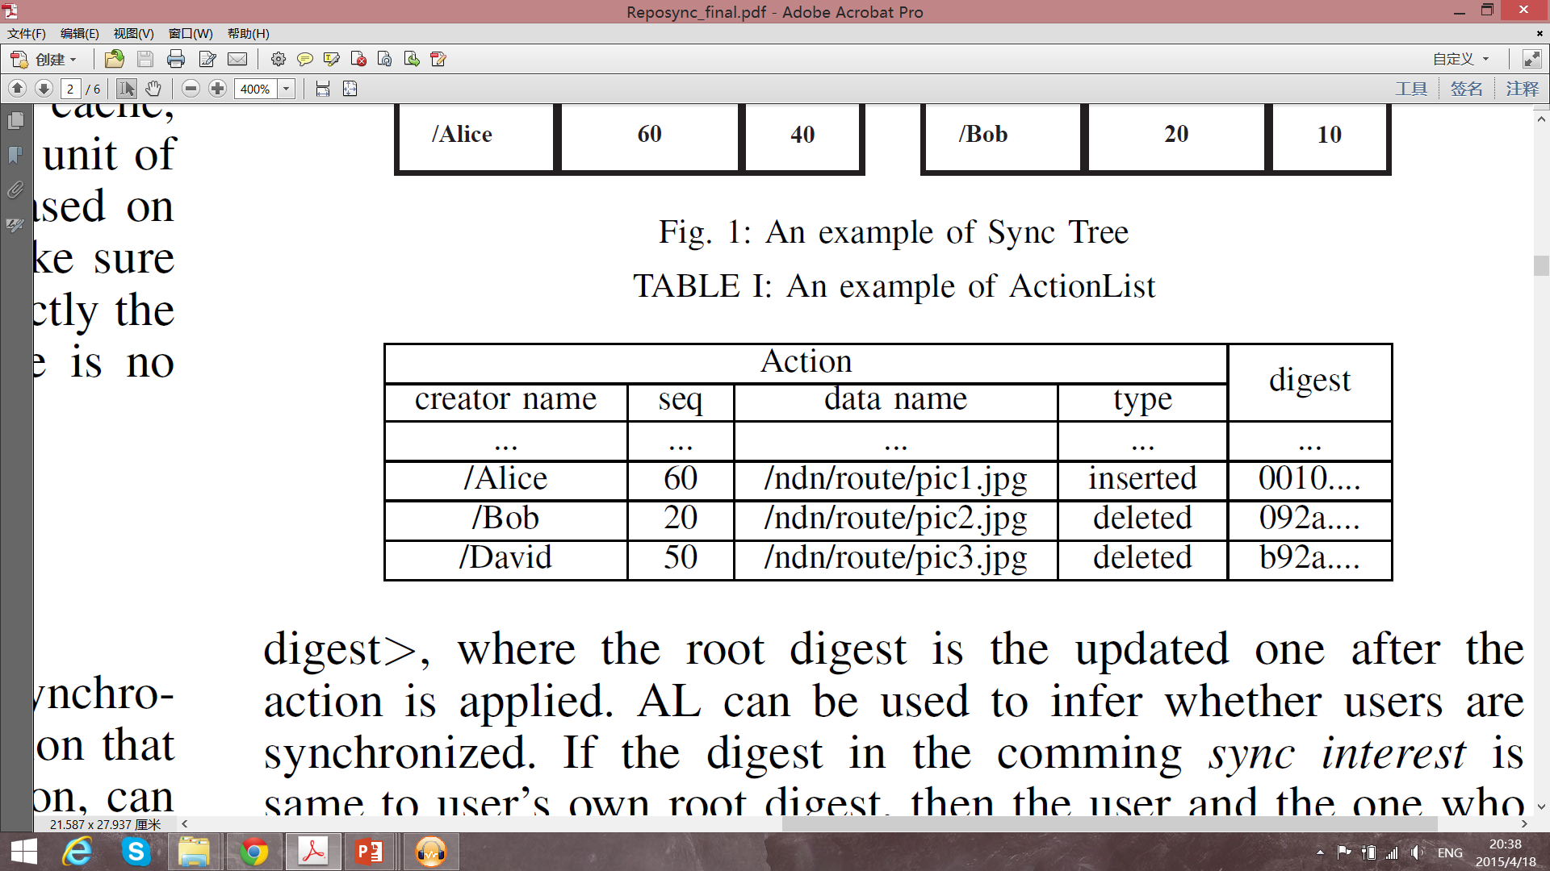
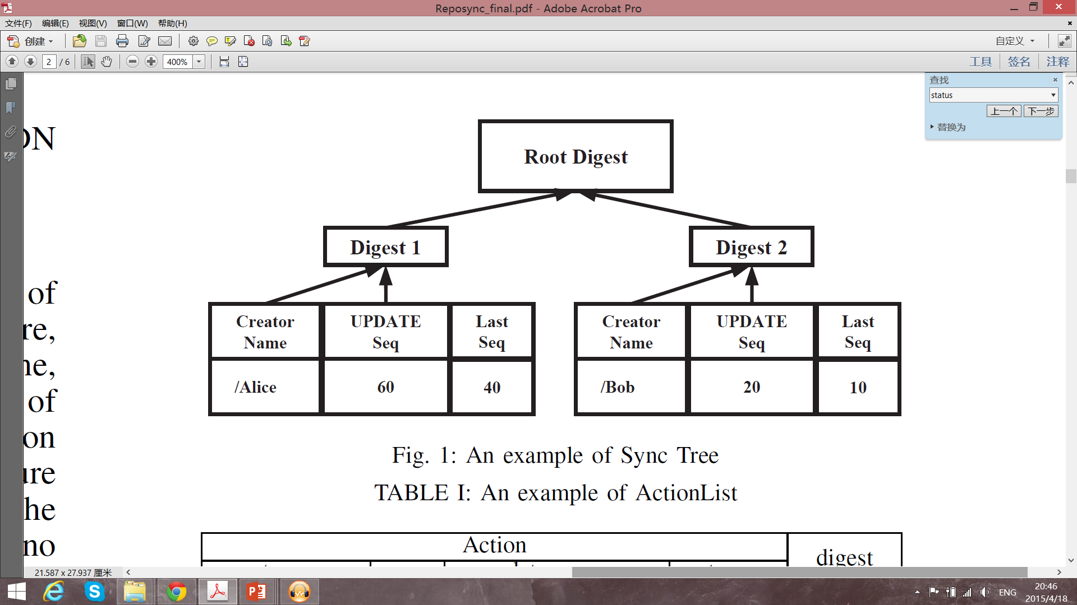
RepoSync: Action-Based Sync
Action list
Action
Resulting fileset state (root digest)
Action
creator name
sequence number
data name
type

Slide 12
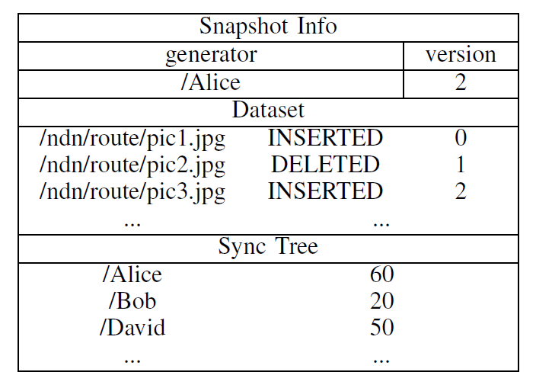
RepoSync: Data-Based Synchronization
Snapshots
Compress actions
Speeding up the sync process
Snapshot
Name of who generated snapshot
Version number
solve potential conflicts
Fileset state
Sync tree
name + min action number
actions < min action number has been compressed by fileset snapshot

Slide 13
RepoSync System Overview
RepoSync
actions
snapshots
file segments
knowledge
about actions

Slide 14
RepoSync Data Types
request new actions, newer than the current state (root digest)
* notify others with own current root digest
Sync Interest
Sync Data
Information about “new” actions
Fetch
Interest
request action
Fetch
Data
action or snapshot*
*Users generate snapshot after the whole network is synchronized after a certain period. At the same time previous actions are removed.
If the removed actions are tried to be fetched, the snapshot will be returned.

Slide 15
RepoSync Data Types (cont.)
Recover Interest
request actions for the state
Sync Data
actions or snapshot*
* If the removed actions are tried to be fetched, the snapshot will be returned.
Data
Interest
request file segment
Normal
Data
file segment data packet

Slide 16
Sync Process: Steady State
Sync Interest is sent periodically
fetch information about new actions
inform others about current fileset state
If root digests are same, then no data will be returned
everybody is synchronized
/ndn/broadcast/sync/b92a...
/ndn/broadcast/sync/b92a...
/ndn/broadcast/sync/b92a...

Slide 17
Sync Process: New Actions in the System
When data is produced
old sync interest is satisfied with new data
new sync interests is expressed
/ndn/broadcast/sync/b92a...
/ndn/broadcast/sync/aab1...
/ndn/broadcast/sync/b92a...
/ndn/broadcast/sync/b92a...

Slide 18
Sync Process: Fetching Action Data
Once sync interest is received
nodes know name of “new” action(s)
start retrieval process of actions using fetch interests
/ndn/broadcast/fetch/David/50
/ndn/broadcast/fetch/David/50
/ndn/broadcast/sync/b92a...
/ndn/broadcast/sync/b92a...

Slide 19
Sync Process: Processing Action(s)
Fetch interest results in
detailed information about action
snapshot with extended information about actions
After action(s) is(are) determined
apply actions locally (file is deleted)
request missing files (file segments)
/ndn/route/pic1.jpg/segment=1
/ndn/route/pic1.jpg/segment=1
/ndn/route/pic1.jpg/segment=1
/ndn/route/pic1.jpg/segment=1
/ndn/route/pic1.jpg/segment=1
/ndn/route/pic1.jpg/segment=1
/ndn/broadcast/fetch/David/50
/ndn/broadcast/fetch/David/50

Slide 20
Sync Process: Sync Failures
When temporary network partitioning or simultaneous data production happens
nodes may receive sync interests with unrecognized digests
/ndn/broadcast/sync/ddb1...
/ndn/broadcast/sync/bbac...
/ndn/broadcast/sync/aaa1...

Slide 21
Sync Process: Recovery
When incoming sync interest is not recognized
signal that there is a filestate with the corresponding sync digest
Request this state using recovery interest
/ndn/broadcast/recovery/aaa1...
/ndn/broadcast/recovery/bbac...
/ndn/broadcast/recovery/aaa1...
/ndn/broadcast/recovery/ddb1...
/ndn/broadcast/recovery/bbac...
/ndn/broadcast/recovery/ddb1...

Slide 22
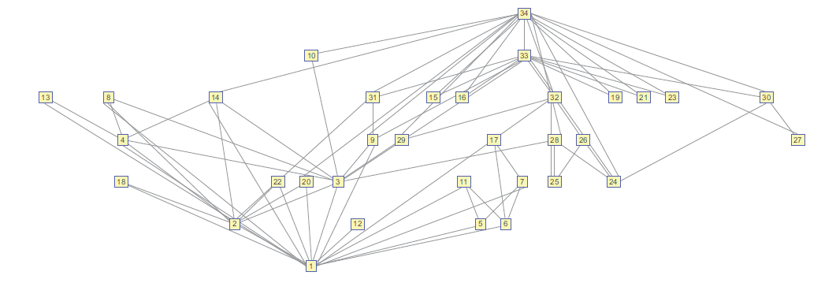
Evaluation
Tools
ndnSIM: NS-3 based NS-3 simulator [3, 4]
Topology
With 34 nodes and 78 links
measurement-inferred delay and 100 Mbps bandwidth.
Scenario
1000 data insertions
20 times for each scenario with 1000 data inserted to each node.
[3] A. Afanasyev, I. Moiseenko, and L. Zhang. ndnSIM: NDN simulator for NS-3. Tech. Rep. NDN-0005, 2012.
[4] S. Mastorakis, A. Afanasyev, I. Moiseenko, and L. Zhang. ndnSIM 2.0: A new version of the NDN simulator for NS-3. Tech. Rep. NDN-0028, 2015.

Slide 23
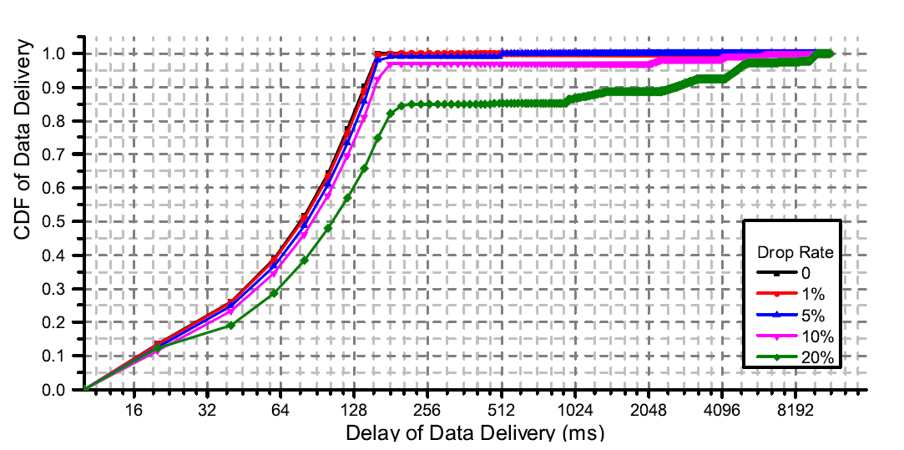
Synchronization in Lossy Environments
Cumulative distribution function for percentage of data that have been synchronized

Slide 24
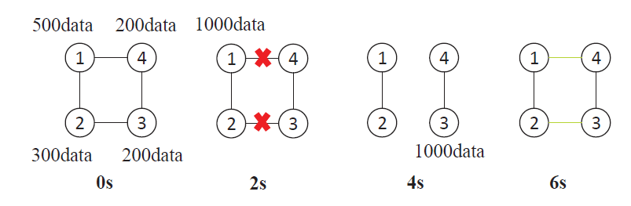
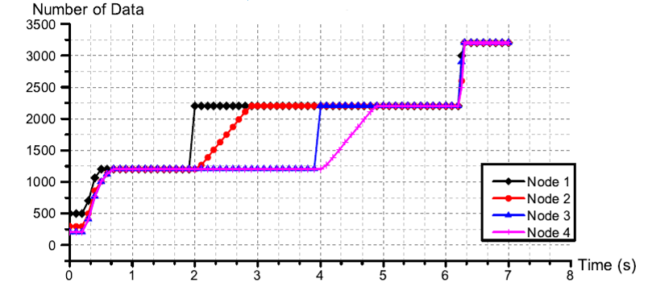
Synchronization in During Network Partitioning

Slide 25
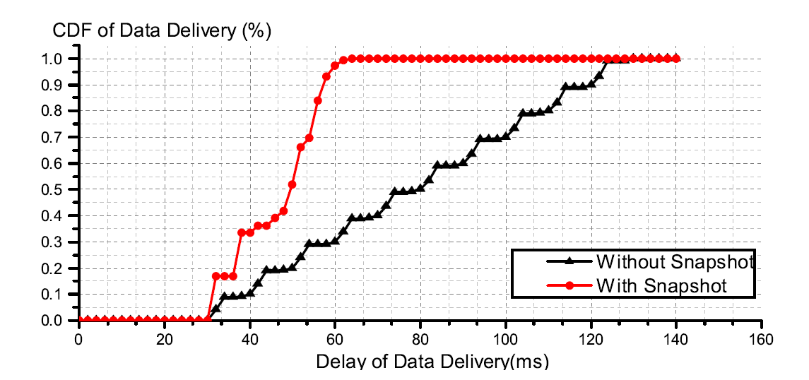
Synchronization with Snapshots
20 new users join in the network, each of which has 100 different data. They are randomly “connected” to the original 34 users.

Slide 26
Conclusion
RepoSync provides distributed and efficient synchronization model
Combines action-based and data-based synchronization
Small editions to the dataset can be propagated via actions
big changes can be directly synced by snapshot
RepoSync support data removal during sync process

Slide 27
Thanks!

